Slide 1

Still Logo Lock-up
Azure Stack HCI: The best of the cloud and on-premises
Sarah Lean - @Techielass
Lisa Clark - @Lisaattheedge

Slide 2




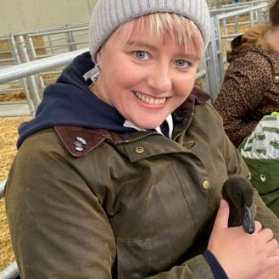


Lisa Clark
Azure Hybrid Pre Sales Specialist
@Lisaattheedge
Sarah Lean
Glasgow Azure User Group Founder
@Techielass

Slide 3


Momentum to a hybrid and multicloud strategy
Hybrid and multi-cloud scenarios
90%
Secure and govern distributed digital estate
of enterprises depend on hybrid
Run edge workloads with cloud-native practices
93%
of enterprises have a multicloud strategy
Meet regulatory and data residency requirements
Source: Gartner Says a Massive Shift to Hybrid Infrastructure Services Is Underway
Source: Cloud Computing Trends: 2020 State of the Cloud Report | Flexera Blog

Slide 4














What is Azure Stack HCI
When to use Azure Stack HCI
Purpose-built HCI operating system delivered as an Azure service
Enterprise class hyperconverged infrastructure
Azure hybrid by design
Familiar management and operations
Hyper-V for secure, efficient virtualization of Windows and Linux
Storage Spaces Direct for fast enterprise-grade storage
Azure inspired software defined networking
Stretch clustering for disaster recovery
Azure Stack HCI resource provider
Management and governance via Azure Arc
Always up-to-date subscription
Native integration with Azure services
Leverage existing concepts and skills in virtualization and storage
Manage with Windows Admin Center, System Center, PowerShell
Continue to leverage 3rd party tools for monitoring, security and backup

Slide 5














When to use Azure Stack HCI
Flexibility with Azure to do it all
Run virtual machines on-premises and easily connect to Azure hybrid services
Azure Arc
Organize and govern
Cloud native apps
Run Azure services
Modernize and secure your datacenter
Run intelligent Edge and remote branch solutions
Azure Stack HCI
Hybrid by design with native Azure Arc integration
Flexible for VM and cloud native with AKS on Azure Stack HCI
Enterprise scale and great price-performance
Familiar management, operations and deployment flexibility
Deploy high-performance workloads
Deploy cloud native apps and Azure Arc- enabled services

Slide 6






What’s new for Azure Stack HCI
at Microsoft Ignite 2022
Making it easier to switch from WS to HCI

Slide 7


What’s new for Azure Stack HCI
at Microsoft Ignite 2022
Making it easier to switch from WS to HCI
Arc-enabled VM mgmt.
Public Preview 2

Slide 8
What’s new for Azure Stack HCI
at Microsoft Ignite 2022
Making it easier to switch from WS to HCI
Arc-enabled VM mgmt.
Public Preview 2
22H2 feature update
Operating system

Slide 9

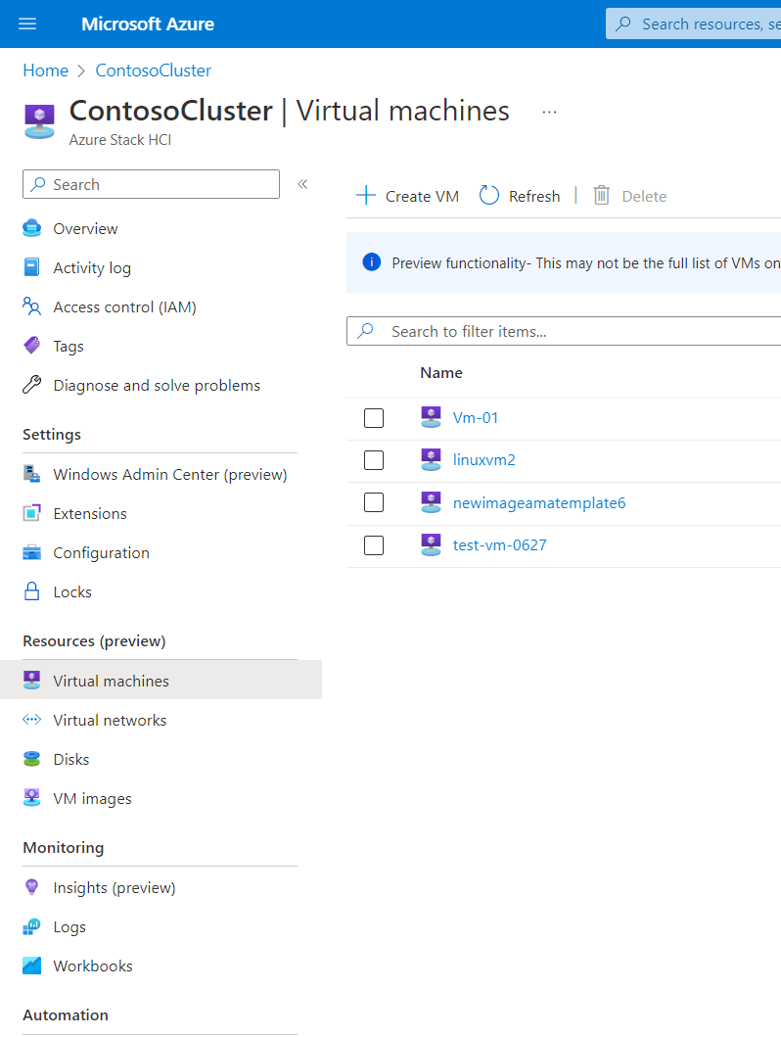
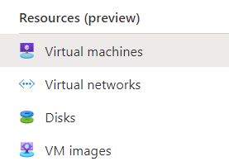
What’s new for Azure Stack HCI
at Microsoft Ignite 2022
Reminder:
What is Arc-enabled VM management?
Provision and manage on-prem VMs from Azure
Cloud-edge UX consistency in Azure Portal
Making it easier to switch from WS to HCI
Arc-enabled VM mgmt.
Public Preview 2
22H2 feature update
Operating system
Arc-enabled
Azure Kubernetes Service
Included with Azure Stack HCI (no additional cost)
Public Preview 1: March 2022

Slide 10

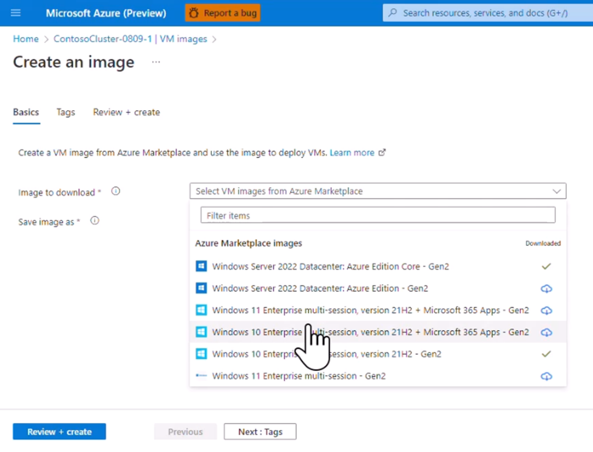

New in Public Preview 2:
Access VM images from Azure Marketplace
Fall 2022
Quick to get started
Fewer steps than preparing a custom image
Always the latest image
From trusted publishers (e.g., Microsoft)
Image lifecycle management
Easily add, remove, update from the Portal
Coming soon…
Third-party publishers!
Preview includes Azure Virtual Desktop and WS Azure Edition images

Slide 11
New in Public Preview 2:
Access VM images from Azure Marketplace
Fall 2022
Quick to get started
Fewer steps than preparing a custom image
Always the latest image
From trusted publishers (e.g., Microsoft)
Image lifecycle management
Easily add, remove, update from the Portal
Coming soon…
Third-party publishers!
Preview includes Azure Virtual Desktop and WS Azure Edition images

Slide 12









What’s new for Azure Stack HCI
at Microsoft Ignite 2022
New in Public Preview 2:
Guest management and VM extensions
Fall 2022
Guest automatically Arc-enabled
Public Preview 2
When created through Arc VM management
Install and configure your applications
With Custom Script extension
Automate OS configuration
Join domain, apply policies, and more
Custom Script
extension
Domain Join
extension
Azure Policy Machine Config
Coming soon…
More Azure VM extensions
On the roadmap
Making it easier to switch from WS to HCI
Arc-enabled VM mgmt.
Public Preview 2
Azure Monitor
(Logs, Metrics, Alerts)
Microsoft Defender for Cloud
Azure Update Management Center

Slide 13
New in Public Preview 2:
Guest management and VM extensions
Fall 2022
What’s new for Azure Stack HCI
at Microsoft Ignite 2022
Guest automatically Arc-enabled
Public Preview 2
When created through Arc VM management
Install and configure your applications
With Custom Script extension
Automate OS configuration
Join domain, apply policies, and more
Custom Script
extension
Domain Join
extension
Azure Policy Machine Config
Coming soon…
More Azure VM extensions
On the roadmap
Making it easier to switch from WS to HCI
Arc-enabled VM mgmt.
Public Preview 2
Azure Monitor
(Logs, Metrics, Alerts)
Microsoft Defender for Cloud
Azure Update Management Center
22H2 feature update
Operating system

Slide 14
What’s new for Azure Stack HCI
at Microsoft Ignite 2022
Making it easier to switch from WS to HCI
Arc-enabled VM mgmt.
Public Preview 2
22H2 feature update
Operating system
Arc-enabled
Azure Kubernetes Service

Slide 15

What’s new for Azure Stack HCI
at Microsoft Ignite 2022
Reminder:
What is Arc-enabled VM management?
Making it easier to switch from WS to HCI
Arc-enabled VM mgmt.
Public Preview 2
22H2 feature update
Operating system
Arc-enabled
Azure Kubernetes Service

Slide 16

What’s new for Azure Stack HCI
at Microsoft Ignite 2022
Making it easier to switch from WS to HCI
Arc-enabled VM mgmt.
Public Preview 2
22H2 feature update
Operating system
Arc-enabled
Azure Kubernetes Service
Azure Stack HCI Pro 2

Slide 17


Discussion

Slide 18






Resources
Azure OpenAI Service – Advanced Language Models | Microsoft Azure
Speech to Text – Audio to Text Translation | Microsoft Azure
More information:
Keep the conversation going!
Sarah Lean @Techielass
https://bit.ly/brkhci
Lisa Clark @Lisaattheedge

